Slide 1
WELCOME!!
There is a volunteer sign-up on the side table.
There are some leftover wish list items on the side table.
Please read the letter written by your child and write a quick letter back to them.
**Please leave those letters to your children here!

Slide 2
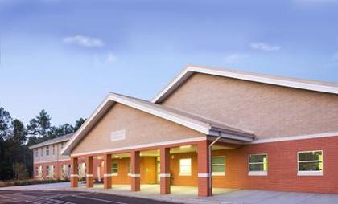
Mrs. Burns’ Open House
Sycamore Creek
Thursday July 16, 2015

Slide 3
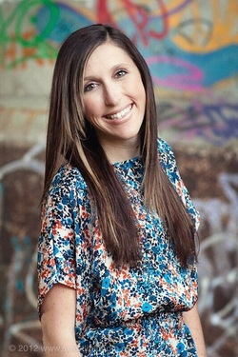
About Mrs. Burns
9th year teaching: 7 years in first and 1 year in second.
Graduated from Appalachian State University.
Expecting our FIRST child this Christmas!

Slide 4
Class Schedule for Room #221
8:00-8:30 Morning Review/Morning Work 8:40-9:05 Letterland 9:10-9:55 Specials (see Room Specific rotation) 10:00-11:00 Math 11:00-11:15 Snack 11:20-11:45 Science/S.S. 11:45-12:10 Writing 12:15-12:45 Recess 12:50-1:15 Lunch 1:20-1:45 Whole Group Literacy 1:50-2:50 Daily 5 Centers/ Reading Groups 2:55-3:00 Pack Up

Slide 5
Class Schedule for Room #225
8:00-8:30 Morning Review/Morning Work 8:40-9:05 Letterland 9:10-9:55 Specials (see Room Specific rotation) 10:00-11:00 Math 11:00-11:15 Snack 11:20-11:50 Writing 11:55-12:25 Recess 12:30-12:55 Lunch 1:00-1:25 Science/S.S 1:25-1:45 Whole Group Literacy 1:50-2:50 Daily 5 Centers/ Reading Groups 2:55-3:00 Pack Up

Slide 6
Specials Rotation Room #221
Specials Rotation Room #225
1. Art 2. Media/Tech 3. PE 4. Science 5. Music 6. Guidance 7. Math Enrichment
1. Music 2. Guidance 3. Math Enrichment 4. Art 5. Media/Tech 6. PE 7. Science
*** These will be written on your homework each week!
*** Media and Technology will alternate throughout the year. We will check out books all year long.
*** Sneakers are MANDATORY for PE.

Slide 7
Report Card/Quarter Schedule
1st Quarter: Ends September 25th
2nd Quarter: Ends December 18th
3rd Quarter: Ends March 24th
4th Quarter: Ends June 30th
**1st Grade will get report cards EVERY quarter. I will also have conferences set up once a quarter through Sign Up Genius.

Slide 8
BYOD
Bring Your Own Device
Something we would like to try to start in First Grade as all the upper grades are implementing this.
Letter at your table explaining a brief summary.
ONLY students may touch his/her device.
Will use for Daily 5 Centers, Reading Groups, Math Practice
Ms. Butker and I will be holding a BYOD meeting/training session for any parent who has a child who will be participating on Wednesday, August 26th from 5:30-6:30. We will be helping you to set up your child’s device.

Slide 9
Curriculum
Math:
-Wake County Alignment Lessons
Daily 5
Students will get a small mini lesson each day
Daily 5 Centers (4 rotations a day)
Read to Self, Work on Writing, Read to Someone, Word Work, Listen to Reading
Reading Groups
Writing:
Letter Land
Week long units with focus on word families, blends, and other letter sounds.
Empowering Writers

Slide 10
Science/ S.S.
We will switch between Science and S.S. every few weeks.
Science standards: Balance and Motion, Measurement, Living Organisms, and Pebbles Sand and Silt
S.S. will be a combination of Character Traits, Holidays, and how we fit into our Community.
On Thursdays we will also do Scholastic Readers.
Fridays are Fun Friday Centers: Students who have finished all assignments for the week will get to choose a Fun Friday Center (i.e. Geoboards, Computers, Pattern Blocks, Math tubs, etc.). Students who haven’t finished his/her work will need to complete the work before attending a Fun Friday Center.

Slide 11
Homework
Newsletter and Homework on same page.
Sent home each Friday for the next week.
Homework is due the following day.
Please keep the Newsletter in the red folder every day so I can put conduct grades daily.
Please try to let your child complete this independently- help when needed and check.
Reading Logs- Suggestions for written response/retell practice on the tables to take home.
Please be reading EVERY night.
Take Home Books on your child’s level will start going home after track out. These will come back every Thursday!

Slide 12
Volunteer Opportunities
Mystery Readers
I would like to invite any parents, older siblings, grandparents, relatives, or other special people to surprise your child by being a “Mystery Reader” this year in our classroom. Students LOVE having their family, friends, and relatives visit our classroom to share in our learning by reading a favorite story aloud to our class. Mystery Readers will visit us on Thursdays from 11:15-11:35ish each week. Readers are asked to bring two or three books to read or read a teacher-chosen book from our classroom library.
Link On class webpage
Field Trips
Parents will have the opportunity to attend our two field trips with us. One will be in the Fall to Hillridge Farm and the other will be in the Spring to Durant Nature Park. More information to come.
Classroom Helpers
I am in need a variety of helpers for various things in the room.
Take home books, Friday Folders, classroom store, etc.
**I would like to try to get steady help in these areas for consistency!!**
Math Tiles
Parents would come in each Friday from 11:15-11:45 to help students complete Math Practice “games” each week.
My Sign Up Genius Link:
http://www.signupgenius.com/FindASignup
And enter mljackson33@gmail.com

Slide 13
Field Trips
Hillridge Farms
Fall
Cost is around $10
Gem Mining, Hayride, exploring the farm.
Forms will be sent home in the next month or two.
Durant Pond
Spring (April)
Minimal cost
Nature scavenger hunt, using nets to search for pond life (frogs, tad poles, fish, etc.)
Forms sent home in March.

Slide 14
Misc. Info
http://www.margieburns.weebly.com/
I will try to update it as often as I can/needed.
PBIS- Class Dojo, croc cash, chompliments
http://www.sycamorecreekes.net/
LOTS of school wide info can be found here.
Birthdays: Birthday in a Bag instead of sweet treats.
Hard candy, trinket- 23 students.

Slide 15
Grading
1, 2, 3, 4 Grading System
1- I don’t get this at all.
2- I can get this with assistance.
3- I can do this on my own.
4- I can extend my thinking without being asked.
They took away 3* this year!!
New report card system and online grade book- PowerTeacher.
MCLASS
Anything with a number grade on it is a graded assignment or assessment. Anything with a check, sticker, smiley, or P or PT (performance task) on it is an assignment I did not take a grade on.

Slide 16
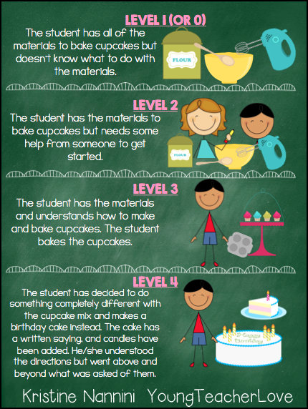

Slide 17
Class Dojo
If you haven’t already, log in as a parent and set your email up for class Dojo. You will get updates on your child’s behavior each day as I give and take away points.
Students get points for a variety of reasons, CHOMP, completing work, etc.
Students lose points for not CHOMPing, completing work, etc.
Each Friday, students will get a dollar for every point they have to spend at the school store.

Slide 18
THANK YOU!!!!
mburns@wcpss.net
*Please leave a short note for your child to read tomorrow morning if you haven’t already!

